Slide 1
UHP Welcome Retreat Meeting #1
Group 13: Ashlyn Stephens

Slide 2
What is the uhp welcome retreat?

Slide 3
UHP WELCOME RETREAT: TRADITIONAL
“The University Honors Program's Welcome Retreat is a tradition that has been going strong for over a decade. Every year, incoming first-year students participate in this overnight experience to form relationships with peers, learn about UC, and have fun!”
-UHP
BENEFITS:
Meet and Make Friends!
Community & Understanding
Inspiring Presentations & Conversations
Fun Challenges & Games
Personal Growth
Development of Critical Thinking Skills
Creation of a Reflective, Global, Mindset

Slide 4
UHP WELCOME RETREAT: DIGITAL
"Small groups made meeting people very easy. It was a great introduction to the kinds of cooperation we will need in the honors program."
-Welcome Retreat Attendee (In-Person)
GOALS:
Meet and Make Friends!
Foster Community & Understanding
Creation of a Reflective, Global, Mindset
Meet People Outside of & Within Your Major
Contacts & Conversation
“Official & Fun” Conversations in the GroupMe

Slide 5
Introductions

Slide 6
Who Am I?
NAME: Ashlyn Stephens
YEAR & MAJOR: 4th Year Middle Childhood Education Major
MINOR: History
CERT: Digital Learning Design
PET(S): None Currently
Sandy 11/20/05-3/5/18

Slide 7
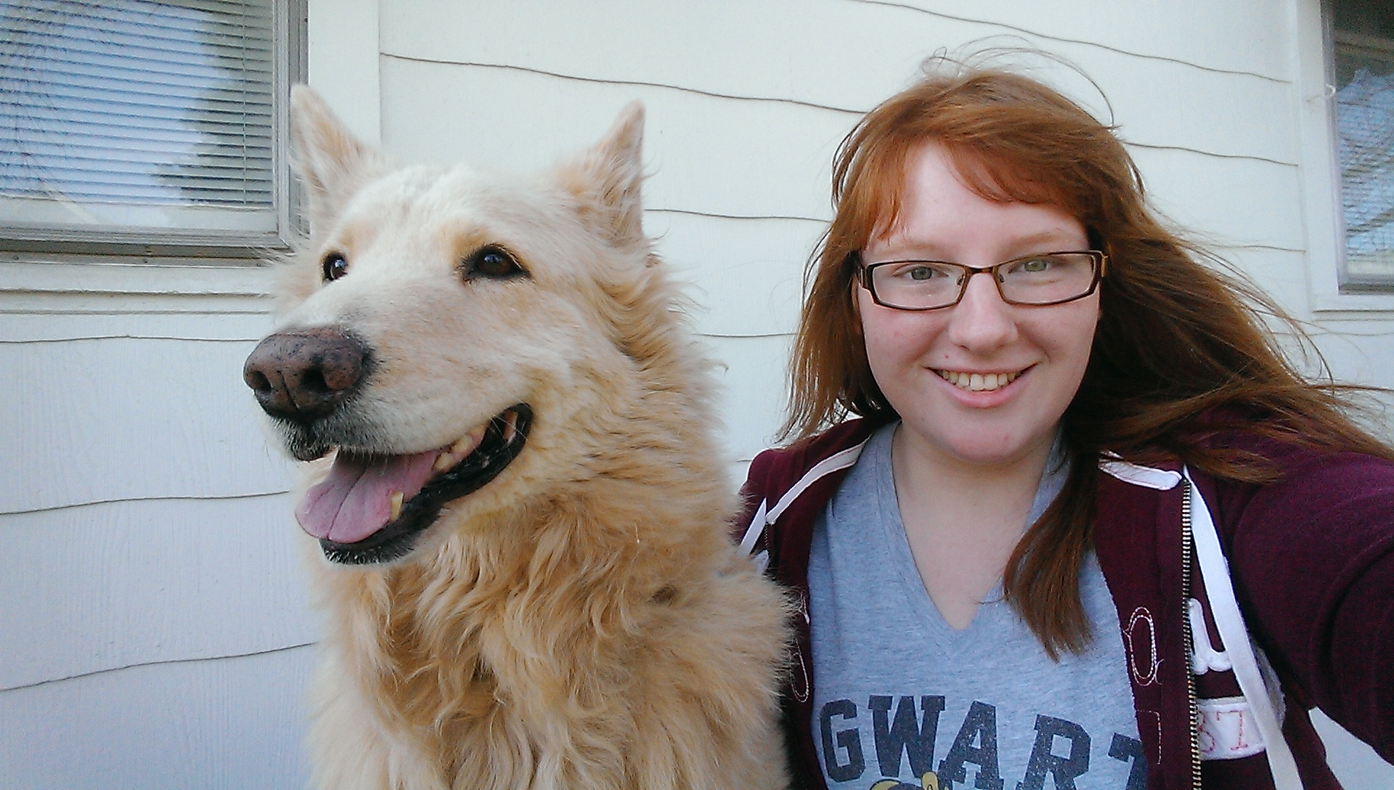
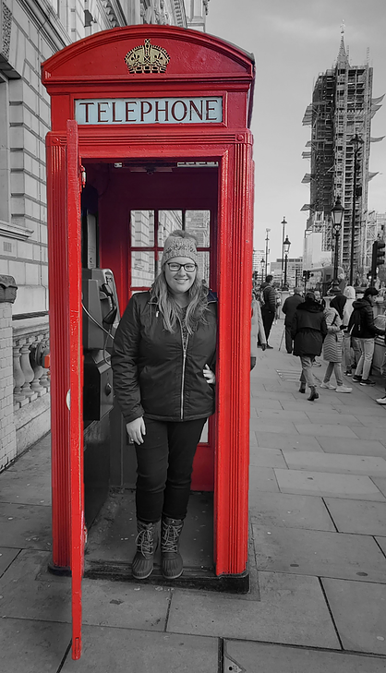
FAVORITE ENTERTAINMENT:
TV SHOW: Lucifer
VIDEO GAME: Pokémon & Sims
OTHER INTERESTS:
Traveling
Violin
Anime
CONCERNS:
Online Course Formats—All (6) of My Courses are Online
Health & Safety: I Work at an Elementary School

Slide 8
Who are you?
Name
Major (If Known)
Do you have any pets?
Favorite TV Show/Movie/Video Game
Other Interests
Hopes or Concerns for the Semester

Slide 9
Important Resources
CAPS (513) 556-0648
Office of Equity and Inclusion
Bearcat Support Network
Identity Offices (EPS, Women’s Center, AACRC, LGBTQI+ Center etc.)
Learning Commons
One Stop -All Online
Honors Office-Advisors
Major Advisors
Accessibility Resources
Transfer & Transition Advising Center (TTAC) (formerly known as Pathways)
Career Guidance
Handshake
Starfish
Campus Link
Night Ride (513) 556-7433
Non-Emergency Police (UCPD) (513) 556- 1111
UC Shuttle Bus (DoubleMap) (513) 556- 4424

Slide 10
COUNSELING & Psychological services (caps)

Slide 11
UC women’s center

Slide 12
AFRICAN AMERICAN CULTURAL RESOURCE CENTER (AACRC)

Slide 13
LGBTQ

Slide 14
LEARNING COMMONS

Slide 15
ONE STOP

Slide 16
ADVISING & ACADEMIC SERVICES

Slide 17
ACCESSIBILITY RESOURCES

Slide 18
+
Bearcat Promise Career Studio
Handshake is a career platform used by the University of Cincinnati where students, career centers, and recruiters come to meet, talk, and share opportunities.
You can search for available jobs on this platform as well as create an employment profile.
As a UC student, a Handshake account has likely already been created for you:
1. Go to the UC Handshake login page
2. Click on "University of Cincinnati Login"
3. Log In with your UC username and password
“The Bearcat Promise Career Studio is a space for students to explore careers and plan for life after college. Whether you’re writing your first resume or interviewing for your first job, we’re here to help! All students are welcome.”
Bearcat Promise career Studio Webpage:
Information about services they provide & how to schedule a meeting included)
https://www.uc.edu/campus-life/careereducation/career-center.html
Career guidance

Slide 19
WHAT IS STARFISH?
Starfish is a scheduling system used by UC to schedule meetings between students and faculty: advisors, professors, et cetera.
HOW TO ACCESS:
Starfish can be found and accessed by:
-Logging into Canopy with your UC Username & Password
-Clicking “Student Tools”
-Clicking “My Advising”
-Your Advisors & Instructors will appear on your “My Success Network”/Homepage
Starfish

Slide 20
WHAT IS STARFISH?
Campus Link is a hub of University organizations and activities ranging from weekly clubs to fraternities and sororities. You can search by interests, subjects, key words, et cetera and contact organizations directly.
HOW TO ACCESS:
Campus Link can be found and accessed by:
Logging onto Catalyst
Clicking “Other Tools” from the Desktop
Clicking the “Campus Link Icon”
Campus Link can also be found by Googling “campus link uc” and clicking on:
https://campuslink.uc.edu/
Campus link

Slide 21
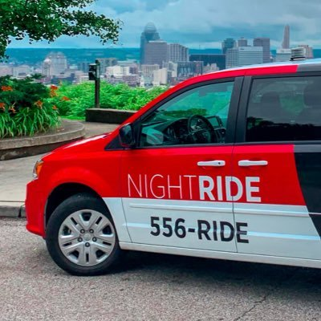
UC NightRide is a free nighttime transportation service for UC students that will take you anywhere within one mile of UC's main campus.
You'll need to have your Bearcat card with you in order to use this service.
(513) 556-7433
CALL: 513-556-RIDE
APP: NightRide
ONLINE: http://nightride.uc.edu
HOURS: Sunday through Wednesday: 8 p.m. to 2 a.m.
Thursday through Saturday: 8 p.m. to 3 a.m. Last call for rides is one hour before closing.
Night ride

Slide 22
You can contact the non-emergency UC police by calling the number to the right →
(513) 556-1111
Non-emergency uc police

Slide 23
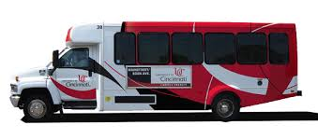
The shuttle routes operate at various times during the academic terms and connect UC's Uptown Campus with the nearby neighborhood, and local and Greater Cincinnati entertainment areas.
Shuttles DO NOT OPERATE on academic term breaks, on official UC holidays, or Winter Season Days or when hazardous driving conditions exist. Please check DoubleMap for up-to-date announcements.
(513) 556-4424
DoubleMap
Can be accessed via website
Or through android/IOS App
http://uc.doublemap.com/map/
Uc shuttle bus

Slide 24
Other Resources (also Important)
STUDENT ACTIVITIES & LEADERSHIP DEVELOPMENT (SALD)
VETERAN’S PROGRAMS & SERVICES
STUDENT WELLNESS CENTER
OMBUDS
DIVISION OF EXPERIENCE-BASED LEARNING & CAREER EDUCATION
PRE-PROFESSIONAL ADVISING CENTER (PPAC)

Slide 25
STUDENT ACTIVITIES & LEADERSHIP DEVELOPMENT (SALD)

Slide 26
VETERAN’S PROGRAMS & services

Slide 27
STUDENT WELLNESS CENTER

Slide 28
OMBUDS

Slide 29
Transfer & Transition advising center

Slide 30
Division of experience-based learning and career education

Slide 31
Pre-professional advising center (ppac)

Slide 32
Advice for the semester
Go to Class ☺: Virtual or In-Person, Attending Class is Crucial to Understanding the Content and Not Falling Behind
Ask for Help When Needed:
Professors
Other Students/Classmates
Advisors
Me
Study
Get Involved & Discover Your Interests
You Get Out What You Put In

Slide 33
Next Steps
MEETING #2
End of First Week of Classes
Take Survey: Link Below + Emailed Out
https://docs.google.com/forms/d/e/1FAIpQLSew9itGH0rP2MWe8evIEMg43GWr5kw5mBCKTP8fD_MhtlDAoQ/viewform?usp=sf_link
COMMUNICATION
Join the GroupMe:
MEETING #3
End of October
Availability Survey Will be Sent Ahead of Time
https://groupme.com/join_group/61372157/okxVyy5z

Slide 34
Questions

Slide 35
SOURCES
IMAGES
UC Bearcat: https://www.collegiateparent.com/university-enews/resource-of-the-month-dean-of-students-office/
UC Logo: https://www.53.com/content/fifth-third/en/personal-banking/about/sponsorships/college-sponsorships.html
Camping Tent: https://www.kindpng.com/imgv/mJRRih_smore-camping-campsite-outdoor-recreation-tent-outdoor-camping/
Cabin: https://www.istockphoto.com/illustrations/log-cabin?mediatype=illustration&phrase=log%20cabin&sort=mostpopular
Laptop: https://www.pngitem.com/middle/hhihRRb_laptop-cartoon-transparent-background-laptop-clipart-hd-png/
Lucifer Promo: https://www.tvguide.com/tvshows/lucifer/781745/
All Might: https://www.pngitem.com/so/all-might/
Plumbob: https://www.pinclipart.com/maxpin/bbRxoJ/
Pumpkin: https://www.pinterest.com/pin/406661041327700020/
NightRide Van: https://twitter.com/ucnightride?lang=en
UC Shuttle: https://ucdirectory.uc.edu/StudentPlanner/Getting_Around_Campus.pdf
Resource Information Based on Training Info. From the UC Learning Commons

