Slide 1
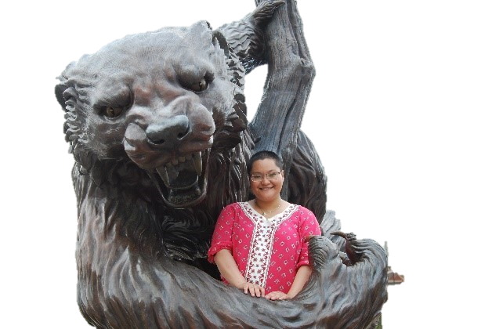
Assignment #1: International Student Interview
Sabrina Shrestha: Nepal
By Ashlyn Stephens

Slide 2
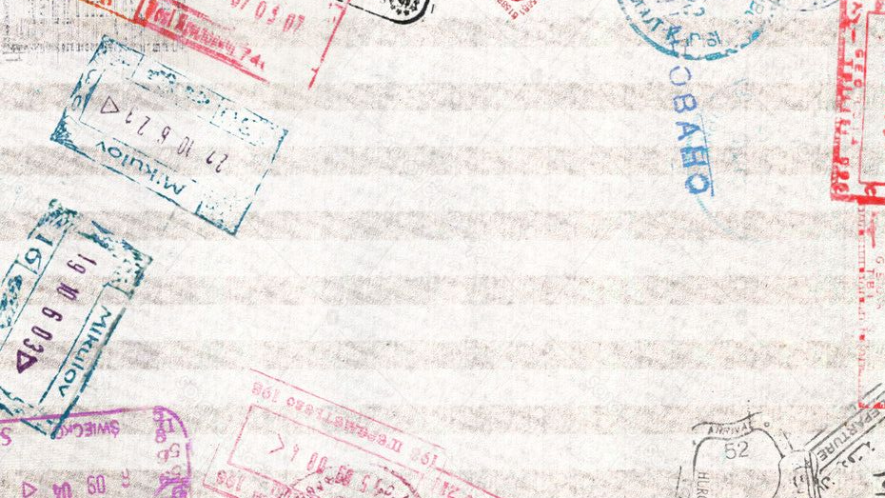
About Sabrina:
SOPHOMORE AT UC: CURRENTLY MAJORING IN AEROSPACE ENGINEERING (PREVIOUSLY BIOLOGY)
Home Country: Nepal
Lives in Kathmandu, Nepal (Capital City)
She has lived in:
Tokyo, Japan
Abudhabi, United Arib Emerates
Paris, France
United States
Due to father’s job as a Nepali diplomat
Went to Secondary School Abroad:
9th & 10th Grade= Paris, France: International school—IB classes
11th & 12th Grade=Nepali High school: A-level (advanced classes: supported/hosted by the university of Cambridge)
Family consisted of Parents, aunts/uncles and close cousins: little contact with grandparents

Slide 3
Caste in Relation to Mythology and Legends
Caste=Ascribed Status: The caste/societal “level” one is born into is where they will remain throughout their life—No social mobility.
Srēsthas (distinct caste) are considered to be the most educated caste and Many of them also occupy high-ranking administrative positions at governmental and non-governmental organizations.
Caste influences beliefs and the prominence of mythology as low-caste communities could be considered comparable to rural societies: Farmers, occupational workers

Slide 4
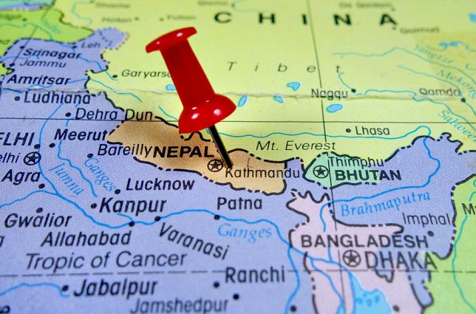
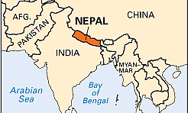
Geographical Location
BORDERED AND STRONGLY INFLUENCED BY INDIA AND CHINA
LIES AMONGST NUMEROUS MOUNTAINS & MOUNTAIN RANGES

Slide 5
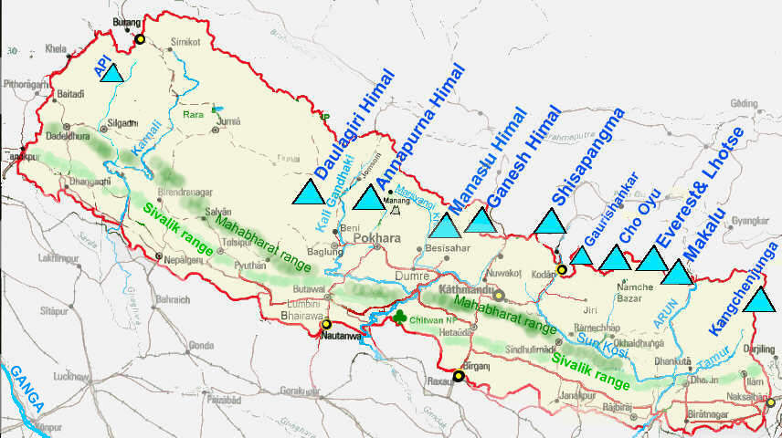
NEPAL’S MOUNTAINS AND MOUNTAIN RANGES
Himalayas (Highest Mountain range in the world)
Mt. Everest
Popular Hiking, mountain climbing and tourist destination/interest

Slide 6
The Yeti
Also known as the Abominable Snowman
The yeti is an ape-like creature taller than the average human
Believed to inhabit the Himalayan and Siberian regions of East Asia (includes Nepal)
Comparable to wildmen
There have been numerous claims of yeti-sightings but most have been discredited as hoaxes or as misidentified monkeys or bears.

Slide 7
The Origin of Kathmandu
THE AREA NOW KNOWN AS KATHMANDU WAS ONCE A LARGE LAKE UNTIL THE GOD MANJUSRI CAME FROM THE NORTH (CHINA) AND CUT THE LAKE WITH HIS SWORD. THE WATER FLOWED OUT OF WHAT WOULD BECOME THE KATHMANDU VALLEY AND THE VALLEY BECAME LUSH. MANJUSRI ESTABLISHED A CITY NAMED AFTER HIM: MANJUPATTAN.
YEARS LATER, THE DEMON BANASUR CLOSED THE OUTLET AND THE BASIN BECAME A LAKE AGAIN LORD KRISHNA KILLED THE DEMON AND ESTABLISHED A CITY AGAIN.

Slide 8
The Role of Religion
Religion of focus: Hinduism

Slide 9
Three Principal Gods of Hinduism
Brahma: The Creator
Vishnu: The Preserver
Shiva: The Destroyer
Not commonly worshipped because it is believed that brahma’s role (creation) has been completed.
Worshipped by a large portion of hindus
PRESERVES/MAINTAINS THE UNIVERSE
Worshipped by a large portion of hindus
if Shiva opens his 3rd eye, the world will end.
Notes:
together they create, preserve and destroy the universe, keeping it fresh and in perpetual motion.

Slide 10
Gods and Goddesses
HINDUISM WORSHIPS ONE ULTIMATE GOD: BRAHMAN—THE FOUNDER OF EXISTENCE. THE VARIOUS HINDU GODS REPRESENT DIFFERENT EXPRESSIONS/MANIFESTATIONS OF BRAHMAN.
GODS ARE OFTEN DEPICTED AS HAVING NUMEROUS LIMBS/HEADS, MERGED WITH ANIMALS AND WEARING TRADITIONAL CLOTHING. GODS/GODDESSES HAVE INDIVIDUAL SPECIALTIES.
PRAYER TO GODS/GODDESSES FOR GOOD LUCK OR TO INVOKE THE GOD/GODDESSES POWER TO RECEIVE/EXPERIENCE DESIRED ACTIONS, EVENTS OR OBJECTS IS COMMON.
EXAMPLE: SABRINA’S UNCLE (VERY RELIGIOUS) PRAYS TO THE GODDESS OF RICHES BEFORE EVERY BUSINESS VENTURE.

Slide 11
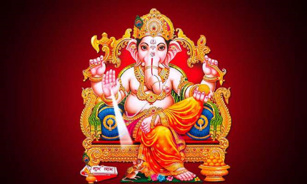
Ganesh
Shiva and his wife Parvati had a son (Ganesh); Shiva was in the Himalayas (where he lived) while Parvati was in the house. Parvati began rubbing off dead skin and molded the skin into a boy (shape) before using her power to bring him to life.
Parvati Told ganesh to guard the door and let no one in while she bathed; ganesh would not let Shiva enter the house upon his return.
The ill-tempered Shiva (not knowing that ganesh is his new son) beheaded Ganesh with his chakra. Upon seeing her dead son, Parvati demanded that shiva bring him back to life. Shiva Threw his chakra and brought back the head of the first living thing his chakra found: An elephant.
GANESH: LORD OF OBSTACLES—PRAYED TO DURING UNDERTAKINGS

Slide 12
Supernatural Beings & Forces

Slide 13
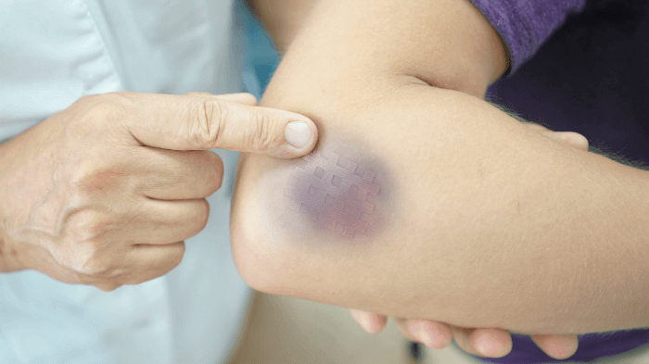
Bokshi Black Magic Witch
Traditional Belief in witchcraft, possessions and ill will inflicted on others through supernatural forces
“Bokshi Bites”
Credited with causing bruises that seemingly appear overnight with no cause. (Primarily referred to by older, “traditional” individuals.
The Bokshi sucks the blood of (sleeping) women to Harm them—leaving a round/oval shaped bruise
Women are still persecuted, Tortured and killed for “witchcraft” in Nepal—Not isolated to location/rural areas
2012—Kathmandu, Nepal

Slide 14
MIDNIGHT MONSTERS AND THE dark
Midnight
Don’t look out windows at midnight! Witches and monsters come out at midnight.
Monster example: A beautiful woman dressed in white with backwards feet that hunts men at night.
FEAR OF THE DARK
SABRINA HAD A FEAR OF THE DARK WHEN SHE WAS 3 OR 4 YEARS OLD (she stated that it was likely because of the warnings about monsters).

Slide 15
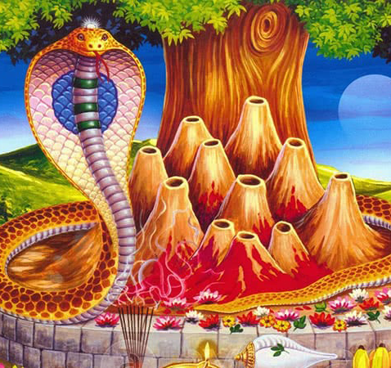
Nag Panchami
Annual Festival
Takes place in india and Nepal
Form of snake worshipping
People bathe snakes in milk in order to ensure their family’s freedom from snakes.
Temples dedicated to snakes and their pictures are honored with ceremonies, music, dancing and offerings of milk and honey
STUCK ON HOUSE GATES WITH COW DUNG: WARDS AGAINST SNAKES

Slide 16
Superstition about snakes
If you kill a snake, crush its eyes afterwards.
The face of its killer will be imprinted on its eyes and its mate will go after the killer seeking vengeance.

Slide 17
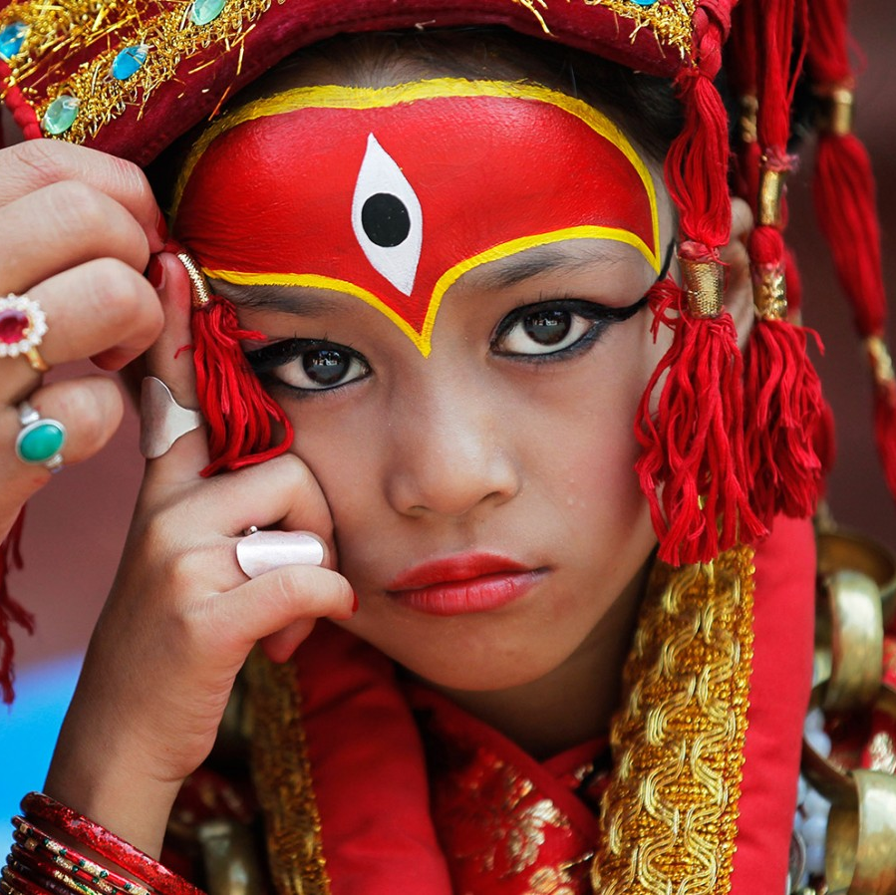
The living goddess: Kumari
Myth:
The Goddess Taleju would meet with The King of Katmandu nightly to play a game of cards/dice. The king was Not allowed to touch or be attracted to the goddess. The king slightly touched the goddess’ hand and she cursed the king to be killed in battle—the king sought her forgiveness and told the king that he must select a “pure” child and proclaim her the living goddess kumari.
Facts:
The girl is selected from only the sakya caste: a Newari caste of Buddhist sakya goldsmiths.
Instated as goddess until she bleeds: either through physical injury or puberty/menstruation. Isolated from the world for 6-7 years in a sacred temple
priests assess the girl’s “godly power/energy” by locking her in a room with the severed heads/remains of sacrificed animals (3 days/3 nights). She must not cry or show fear.

Slide 18
Spirits, Demons and “Graha”
Spirits
. Dwell in abandoned/dark places. If a place has been uninhabited for a long time, a religious ceremony is performed by a priest to ensure the house is clean/absent of spirits.
Demons
Demons are usually depicted as being dark-colored (brown, black, dark green). For some, There is a stigma about wearing Dark color: they carry bad “auras”—Ex: Sabrina’s uncle
Animals and Spirits
Dogs are considered good and able to sense spirits.
“GRAHA”=THE AURA/FEELING ASSOCIATED WITH A LOCATION
BAD “GRAHA”=BAD FEELING ASSOCIATED WITH A LOCATIONS
(LIKELY CAUSED BY THE PRESENCE OF SPIRITS)
Boo!

Slide 19
The sixth sense & Connection
Sixth Sense:
The Shrestha family believes in a Sixth sense that is passed through generations (skips generations)—passed through females
Last hypothesized case: Sabrina’s Great-grandfather’s sister
Connection:
Strong feeling indicating the conflict or harm of others—noticed across great distances
Sabrina and her parents’ medical conditions
SENSING DEATH:
ONE CAN SENSE THE PROXIMITY OF DEATH
The day Sabrina’s maternal grandfather died, he stated that he said, “today, I’m going.”

Slide 20
Perspectives

Slide 21
Ceremonies: Marriage & Coming of Age

Slide 22
MARRIAGE TO AN APPLE AND THE SUN
IHI (BEL MARRIAGE) CEREMONY: OCCURS AT APPROXIMATELY AGE 7
BAHRA CEREMONY: OCCURS BEFORE THE ONSET OF PUBERTY (AGES 9-12)
WHY?
IN NEPAL’S PATRIARCHAL SOCIETY, WIDOWS ARE HISTORICALLY (AND PRESENTLY) TREATED AS OUTCASTS. IF THE MALE HEAD OF HOUSEHOLD DIES, THE FAMILY EXPERIENCES A LOSS OF RESPECT AND CREDIBILITY IN THE COMMUNITY.
IN ADULTHOOD, IF A WOMAN’S PHYSICAL (HUMAN) HUSBAND DIES, SHE WILL STILL BE MARRIED TO HER PLANT AND THE SUN (IMMORTAL).

Slide 23
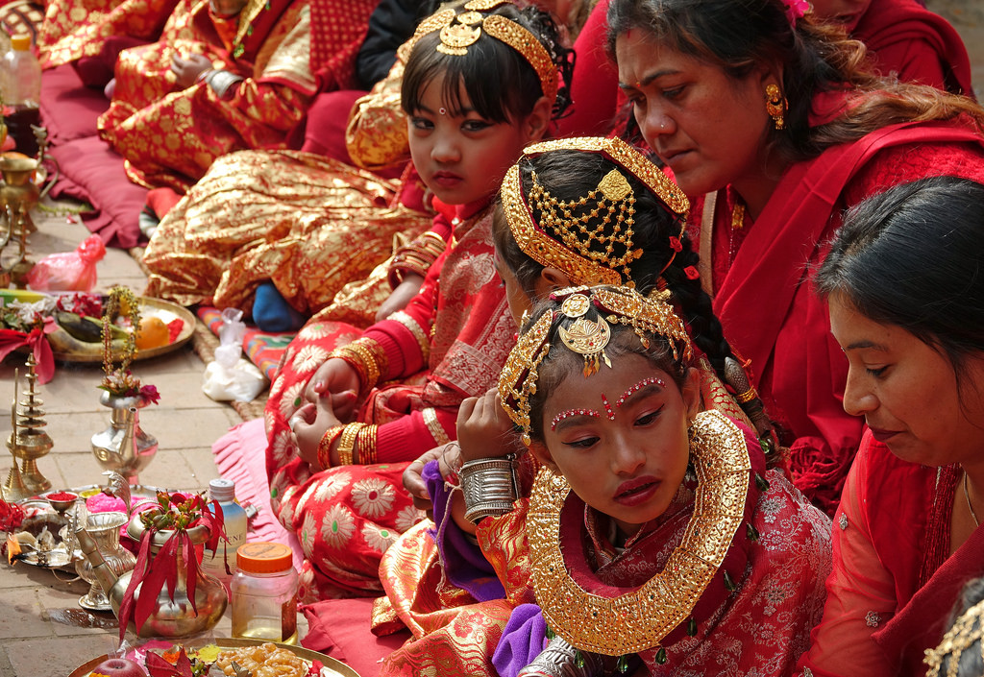
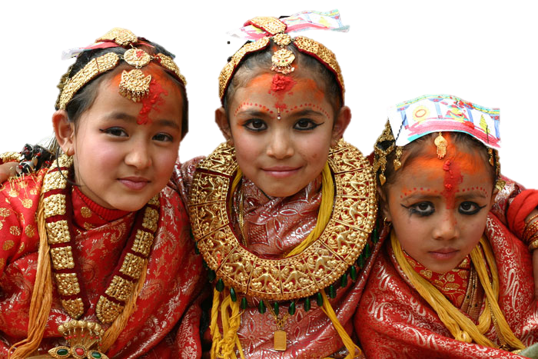
Ihi (or Ehee): Bel Marriage
Occurs under the age of 8: Sabrina completed ceremony at age 6
A group of 20—30 Girls undergo the ceremony at the same time. Dressed in traditional clothing and makeup, the girls travel to the yard of a religious estate and undergo a series of religious ceremonies in which they are married to the Bel plant. After the ceremony, the girls go inside the temple and eat a feast. The girl is supposed to keep her plant husband with her and keep it safe.
TAKES PLACE OVER TWO DAYS
GIRL IS MARRIED TO A GOLDEN STATUE OF LORD VISHNU AND A BEL FRUIT (WOODEN APPLE) IS GIVEN—WITNESS.
THE BEL FRUIT DOES NOT ROT AND REMAINS FRESH FOREVER—BECAUSE OF THIS, IT IS SOMETIMES CONSIDERED AN INCARNATION OF THE GOD.

Slide 24
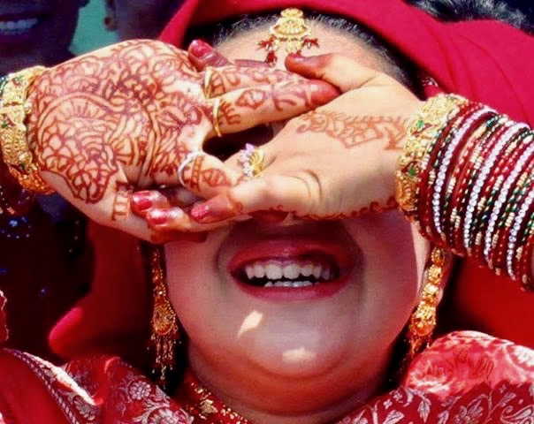
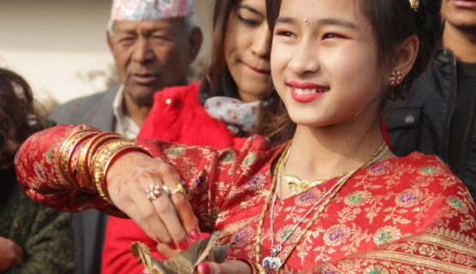
Bahra ceremony: Bahra tayegu
CAVE CEREMONY
OCCURS BEFORE THE ONSET OF PUBERTY (AGES 9-12)
A GROUP OF PRE-PUBESCENT LIVE IN A ROOM/“CAVE” FOR 12 DAYS WITHOUT SUNLIGHT. NO CONTACT WITH MALES.
WHATEVER IS TOUCHED IN THE ROOM MUST REMAIN IN THE ROOM.
ON THE 12TH DAY, THE GIRL BATHES BEFORE SUNRISE AND WEARS A TRADITIONAL WEDDING DRESS—RED SARI—AND HEAVY GOLD JEWELRY.
UPON LEAVING THE ROOM/“CAVE” THE FIRST THING THE GIRL MUST SEE IS THE SUN—THE GIRLS ARE BLINDFOLDED AND TAKEN OUTSIDE; THEY MUST LOOK DIRECTLY INTO THE SUN WHEN THE BLINDFOLD IS REMOVED.

Slide 25
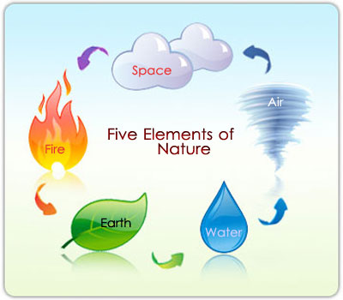
Death
Recognition of death’s “unknown”
The older generation is more concerned with what happens after death; The Younger generation is more concerned with the creation of the world.
Most in Nepal are cremated after death—In conjunction with Hindu beliefs
Hindus believe that cremation releases the body back into its five "elements” (initial pre-being state)

Slide 26
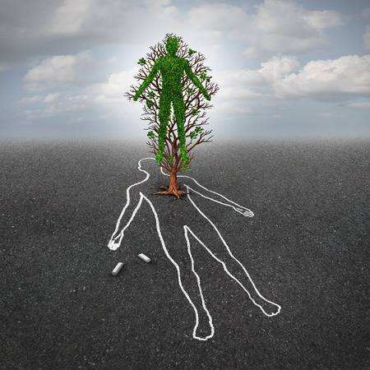
Hinduism Beliefs about death: Is there an “Afterlife”?
When death occurs, the soul travels to another world for a time & returns again to earth to continue its journey
No Heaven or Hell (Traditional Hindu Belief)
Great souls (divine rulers, living gods, etc.) achieve salvation but most souls find a new body inhabit and start a new life—this can be an animal, plant, etc. (8.4 million species)
—While traditional (religious) beliefs are widely held, many observe the presence of a “good” afterlife (where righteous people go) destination and an “underworld” (where bad, immoral, people go) and such distinction influences their actions.

Slide 27
Timeline of death—Traditions of Hinduism
Timeline is very important:
First 9 days After death– the soul is still connected to the body
10th day–the soul (jiva) finally understands it has to leave
10th, 11th, 12th days–old rituals performed to reduce number of obstacles for the soul as possible
13th day – celebration of sweets (the soul is on its way!)
A rite (srardham) is done on a monthly basis to remember the dead

